Slide 1


Sustainability
in Capital Markets
Abdulrahman AlFailakawi, Director of Markets Regulation
Zamzam Alali, Senior Analyst
Markets Regulation Department
Capital Markets Authority
09 February 2026

Slide 2



Table of Contents
1 What is Sustainably/ ESG?
2 Sustainability/ESG Issues
3 Why Do We Regulate Sustainability?
4 Recent Regulatory Updates
5 Regulatory Trends
6 Kuwait's Commitment to Sustainability
7 CMA’s Regulatory Framework
8 Closing Thoughts

Slide 3
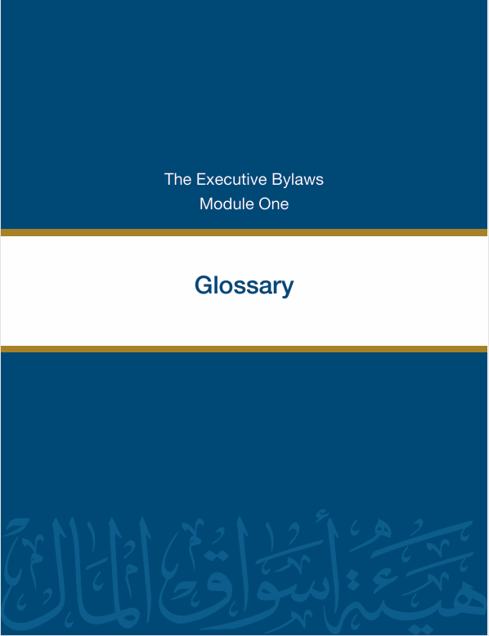
What is Sustainably/ ESG?
Sustainability:
"The development that meets the present needs without compromising the ability of future generations to meet their own needs. The pillars of Sustainability are the economy, the environment, and society."
ESG:
A set of standards used by investors to evaluate an organization’s performance. And it stands for environmental, social, and governance.

Slide 4




Sustainability/ESG Issues
Environmental | Social | Governance
Climate Change | Working Conditions | Board Structure
Stress on Natural Resources | Labor Rights | Business Ethics
Pollution | Stakeholder Opposition | Executive Pay
Waste | Product Liability | Reporting & Transparency

Slide 5

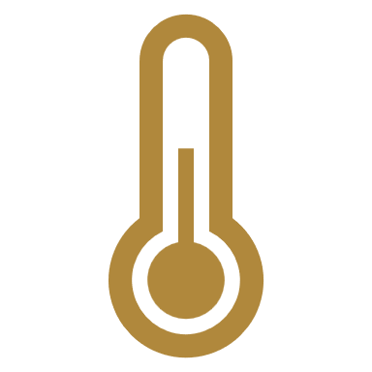


Deep Dive: Environmental Issues
Stress on
Natural Resources
Climate Change
  Extreme weather events
  Global warming (main driver is gas emissions i.e CO2)
  Plants and animals (biodiversity)
  Fresh water
  Metals and minerals
Pollution
Waste
  Harms the environment and living species
  10% of all deaths!
  Harms the environment and living species
  Solutions could save costs (recycling)

Slide 6




Deep Dive: Social Issues
Working Conditions
Labor Rights
  Health & safety
  Rana Plaza incident
  Minimum wage, child labor, equal pay
  Right to organize (unions)
Product Liability
Stakeholder Opposition
  Engage with the community
  Communicate with transparency
  Companies know their products more than customers
  Legal repercussions

Slide 7



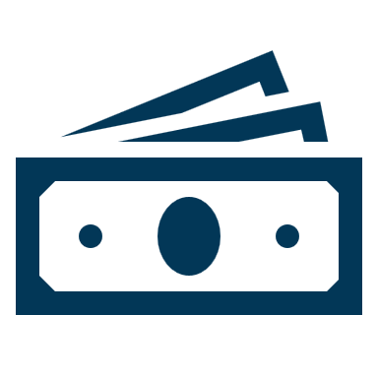
Deep Dive: Governance Issues
Board Structure
Business Ethics
  Skills
  Diversity
  Independence
  Culture that supports governance
  Ethical practices, and combating corruption
Reporting & Transparency
Executive Pay
  Must be disclosed to shareholders
  Fixed pay / bonus
  Integrity of financial statements
  Audit committee

Slide 8

Why Do We Regulate Sustainability?
Sustainable investments has gained prominence and are set to expand further to meet future commitments
2

Slide 9
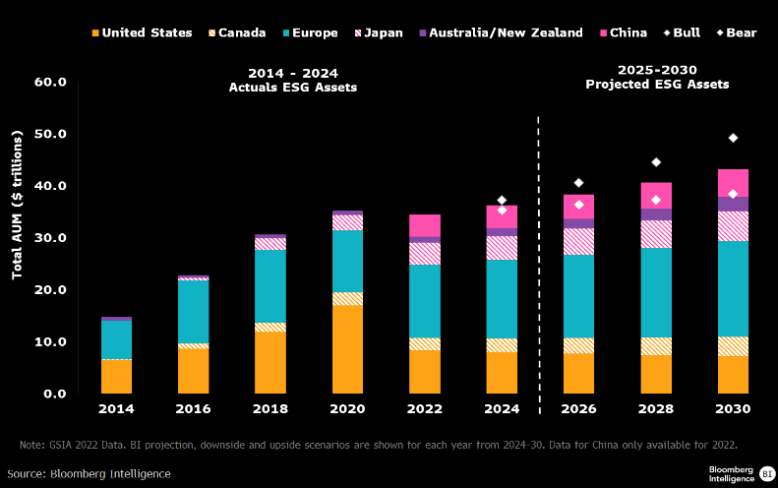

Investing in Sustainable Assets
Sustainable investing to reach $35 trillion in AUM by 2030, comprising over 25% of total AUM. (Bloomberg)

Slide 10
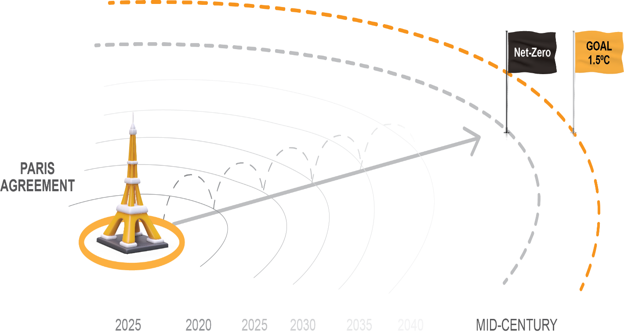
Investing in Sustainable Assets
Minimum of $4T required annually to reach net-zero emissions target (2030-2050). (IEA)

Slide 11
Investing in Sustainable Assets
75% of institutional investors incorporate ESG factors into their investment processes. (MSCI Survey)
77% of retail investors are interested in sustainable investing. (Morgan Stanley 2024)

Slide 12




Why Do We Regulate Sustainability?
44% of global investors think that corporate reporting contains unsupported claims (PwC Survey-2024);
1,841 incidents of misleading communication were recorded in 2024/2025, 56% of it were linked to environmental issues (greenwashing);
High-risk incidents surged by 30% in 2024/2025 (RepRisk);
WEF Global Risks Report 2024/2025:
  5 of the top 10 global risks over the long-term are Environmental.
  2 of the top 10 global risks over the longer-term are Societal.
3

Slide 13


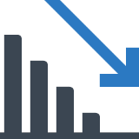
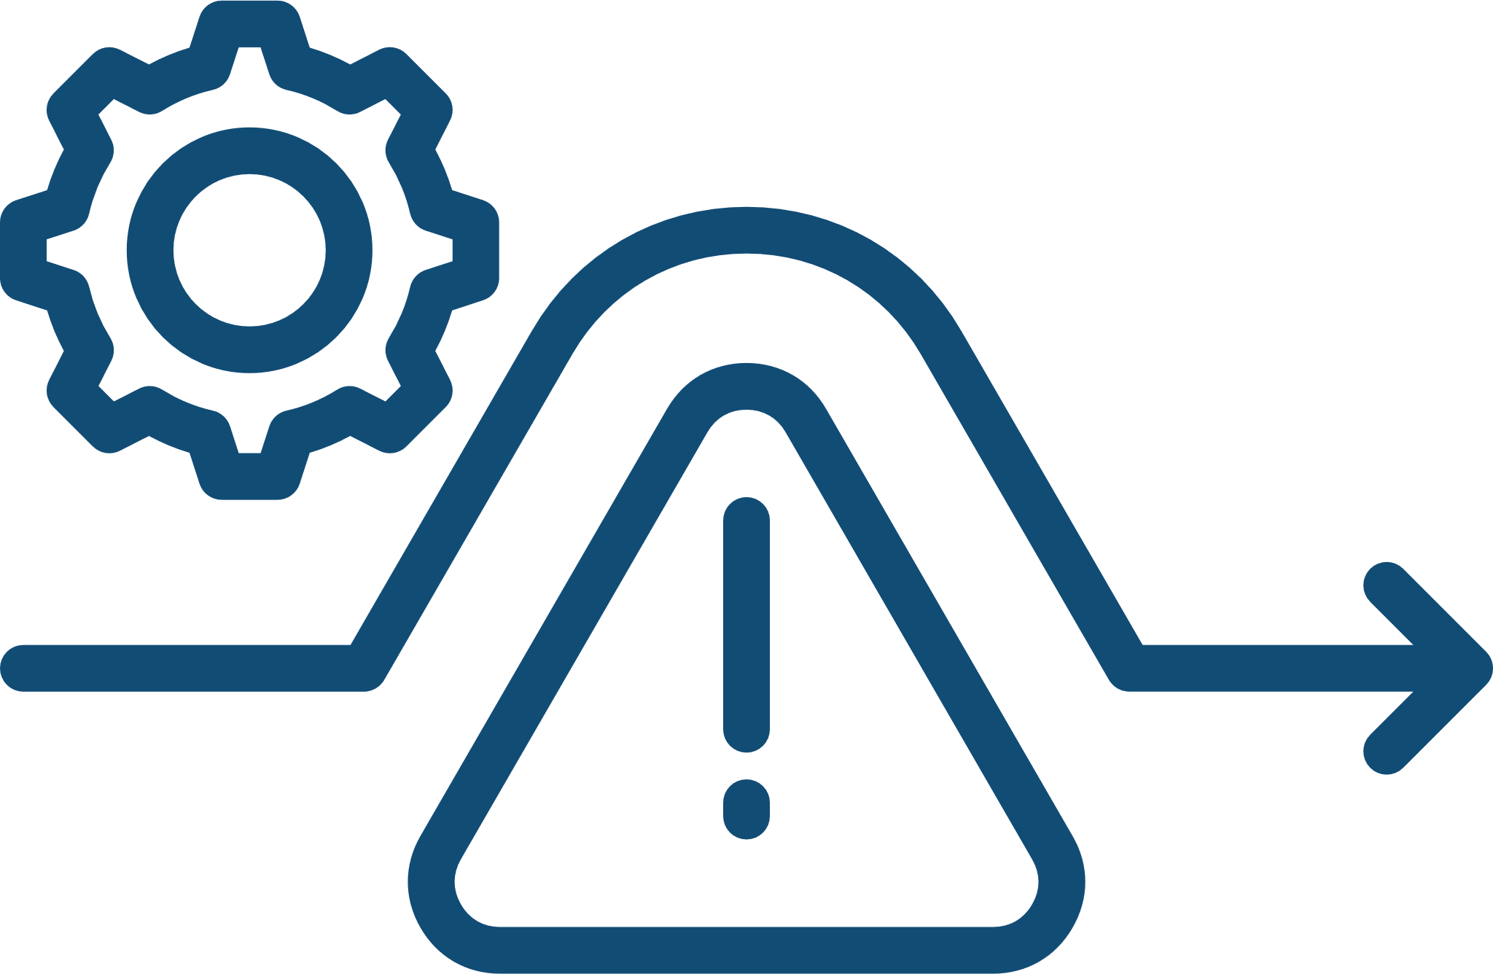


Why Do We Regulate Sustainability?
PROTECT INVESTORS
AVOID SYSTEMIC RISK
RepRisk-2024/2025
Greenwashing:
The act of making false or misleading statements about the environmental or sustainable benefits of a product or practice.
ENSURE TRANSPARENCY
4

Slide 14

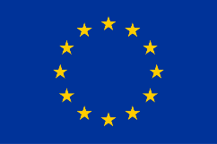







Recent Regulatory Updates
International Financial Reporting Standards IFRS) Sustainability Disclosure Standards (ISSB Standards)
Provide unified reporting standards for investors. Effective, January 2024 (jurisdiction based).
European Union's Corporate Sustainability Reporting Directive (CSRD)
Mandatory, effective January 2024, set to impact 50,000 companies across the European Union.
U.S. Securities and Exchange Commission (SEC) Climate Disclosure Rules
Effective in March 2024, public companies are required to disclose all material climate related risks, and greenhouse gas emissions.
Hong Kong Exchanges and Clearing Limited (HKEX) Rules
New disclosure rules aligned with ISSB, effective January 2025.
Australian Mandatory Climate Reporting
Starting January 2025, Australia requires over 1,800 companies to disclose climate-related financial risks.
5

Slide 15
Regulatory Trends
Transition from voluntary to mandatory schemes
Focus on enhancing reliability and verification (third-party assurance?)
Expanded impact to smaller firms (value chain-CSRD implications)
Global alignment on reporting standards
“Climate First” approach
Carbon Markets Guidelines
6

Slide 16

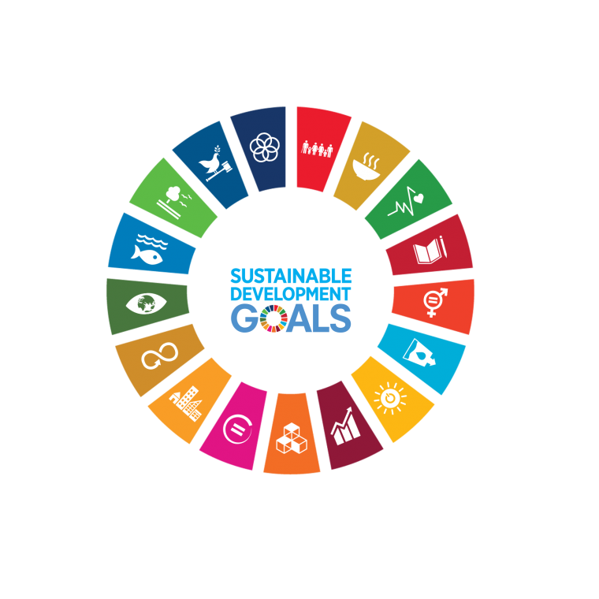
Kuwait's Commitment to Sustainability:
Net-Zero Goals, SDGs, and Evolving Market Dynamics
Net-Zero Commitments
The government has pledged to reach net-zero emissions in the oil and gas sector by 2050 and by 2060 for the whole country.
Public markets can provide an enabling environment to fund sustainable initiatives
SDGs Contributions
Kuwait committed to contributing to the Sustainable Development Goals (SDGs), contribution is incorporated in pillars established in Kuwait Vision 2035.
7

Slide 17
CMA’s Regulatory Framework on Sustainability
Reporting Requirements
Governance
(Board Level)
Mutual Funds
Voluntary;
Internationally recognized reporting standard/s;
Engage stakeholders;
Material topics;
Third-party assurance is allowed
Integration of ESG issues into operations (where needed);
Include sustainability factors in strategic planning;
Incorporate sustainability risks into overall risk management and assessment
Definition of sustainable (ESG) fund;
Conditions: alignment with sustainability goals, inclusion of ESG factor/s, ESG investing approach
Report confirming alignment
8
8

Slide 18
Observations – Sustainability Reporting
Clear Disparity Between Market Segments
Variations in the Timing of Disclosures
Positive Trends in the Premier Market
A noticeable gap exists between premier and main market issuers in terms of sustainability reporting practices.
Sustainability reports are being published in different times around the year by issuers.
Within the premier market segment, companies have demonstrated both the capability and a proactive approach toward publishing detailed and transparent sustainability reports, as evidenced by recent survey findings.
9
9

Slide 19

Observations- Sustainability Reporting
Report Submission Rates:
Nearly, 70% of premier markets issuers published sustainability reports in 2025.
Only 5% of main markets issuers published sustainability reports in 2025.
GRI is the most used reporting standards, followed by SASB.
65% of reports are assured by third-parties
65%

Slide 20
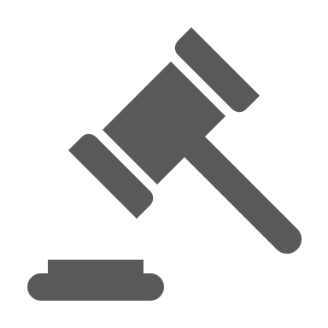



Observations – Sustainability Reporting
Gradual move from voluntary to mandatory schemes
  Positive survey results led to adopting a phased approach (premier then main),
  CMA issued a circular mandating sustainable reporting from Premier listed companies.
Unifying reporting period
  Relevance of information declines with time,
  Investors look for timely, consistent disclosures
  Ideally coincides financial reporting.
ISSB Standards Adoption
  CMA joined IOSCO’s GEMC ISSB Adoption Network (31 jurisdictions in total).
  Currently developing a roadmap to adopt the standards.
  Mandating other well recognized standards (GRI, SASB, TCFD) should facilitate implementation of ISSB standards.
Assurance for
Sustainability Reporting
  Heightened attention on reliability and credibility by investors (and other stakeholders).
  If mandated, might also be implemented in a phased approach (premier vs main, limited vs reasonable).
  International Ethics Standards for Sustainability Assurance (IESSA).
13

Slide 21




Evolving market dynamics, rising investor focus, and global sustainability goals are driving constant updates to regulations.
Closing Thoughts
and Key Takeaways
Regulations are the baseline for transparency but should not be the starting point for integration.
Sustainability is voluntary, but its value is undeniable.
The CMA released its first sustainability report for the fiscal year (2024-2025).
14

Slide 22
Questions?
14

Slide 23
THANK YOU!
14

